Slide 1
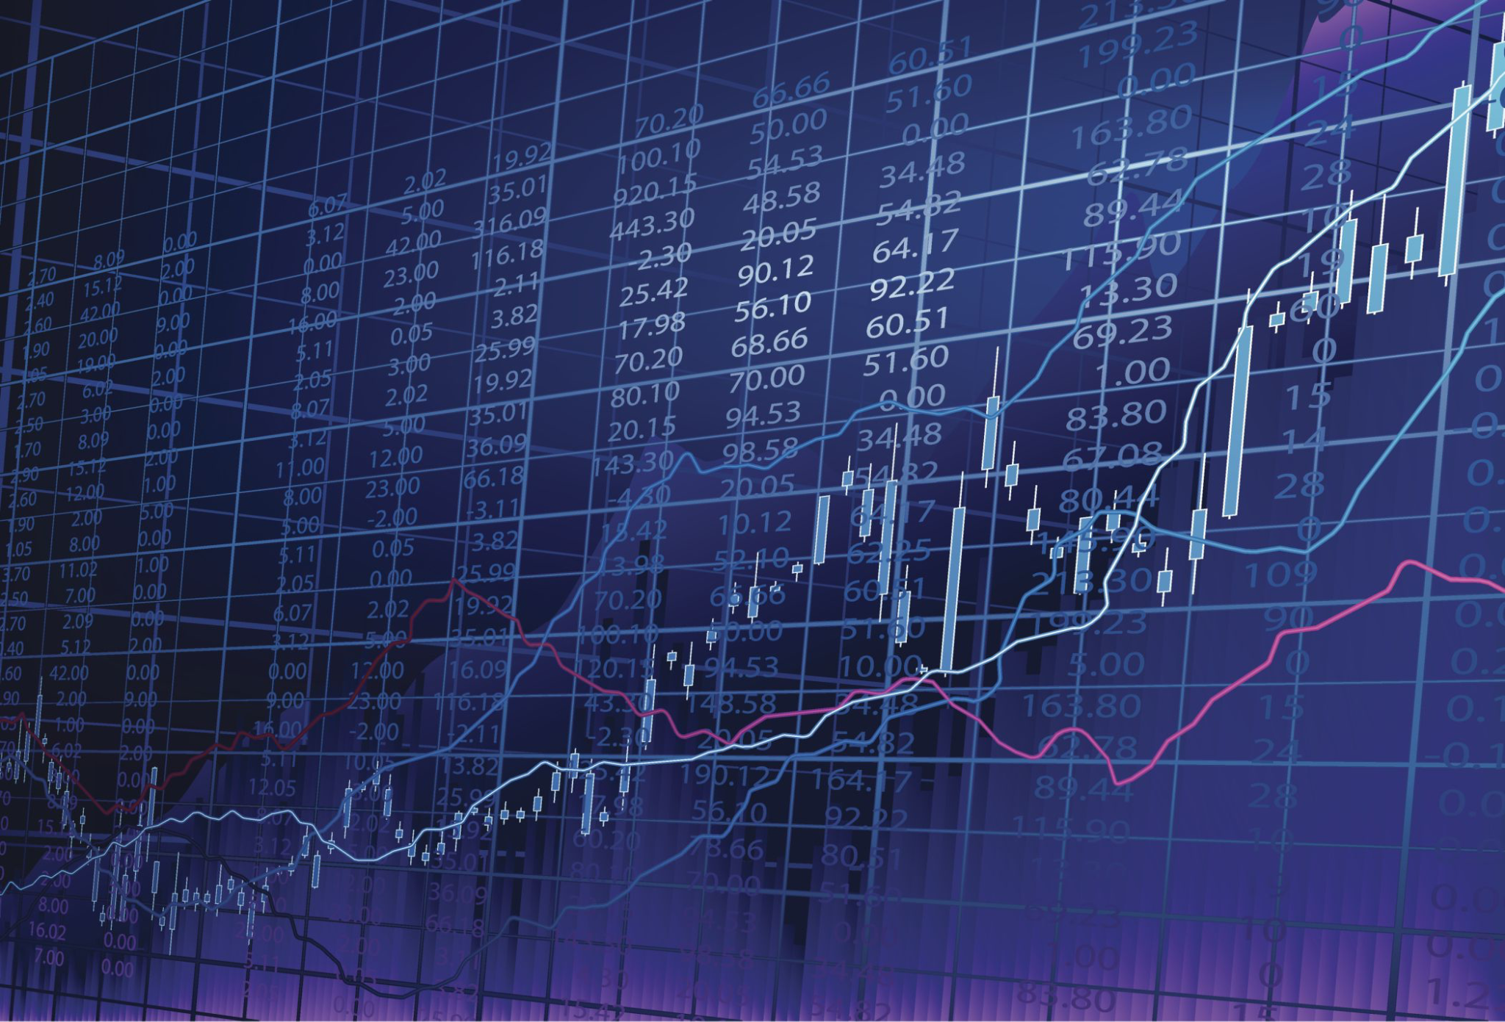
Stock Price Analysis

Slide 2
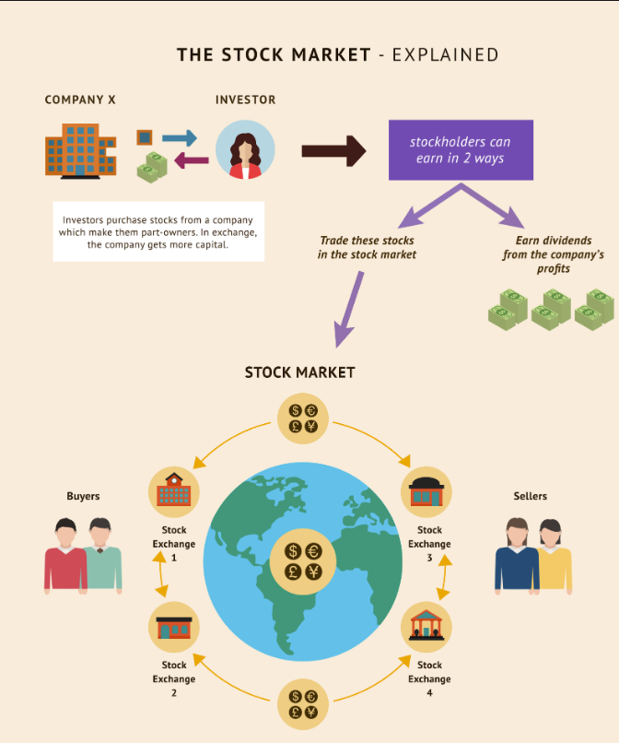
What is a Stock?
Stocks are the basic units of a company.
Based on the demand for a stock, the price can move up or down.
Stock Market is a place where investors buy and sell shares in companies.

Slide 3
Important Terminology
Term | Description
Open | Opening price from the first transaction of the day
Close | Last price anyone paid for a share during the business hours of exchange
High | Highest price paid for a share during the day
Low | Lowest price paid for a share during the day
Volume | Total number of shares exchanged during the day
SPY | Popular fund that tracks the Standard & Poor's (S&P) 500 Index, which comprises of top 500 U.S. companies

Slide 4
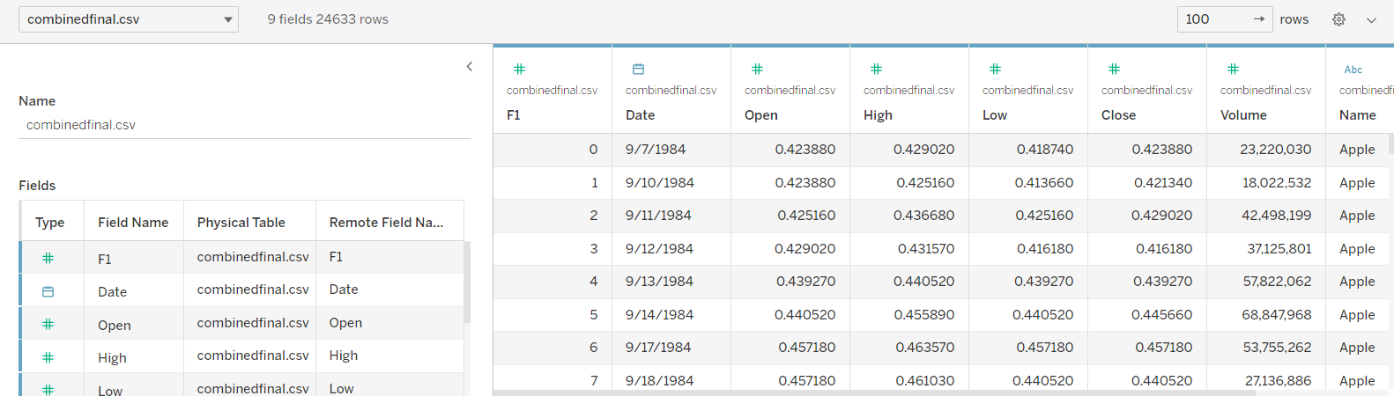
About the Dataset
The dataset contains data from the year 1984 to 2017 of the FAANG and SPY
The dataset contains around 25K rows

Slide 5
Visualization Goal
Create visual representation of stock performance over any given period
Establish relative performance of FAANG stocks compared to a standard fund (SPY)
Answer some of the “what if” questions through visualization
If you invested $1,000, how much would you have now?
If you invested $100 weekly, how much would you have now?
Summarize all the visualizations into a story

Slide 6
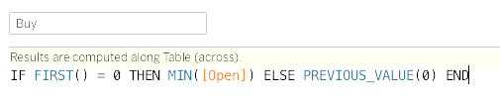
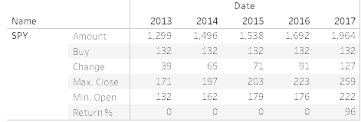
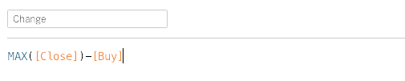
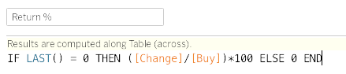
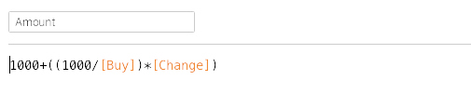
Calculated Fields ($1,000 growth)
Buy - price at which a share was bought
Example of SPY from 2013 to 2017
Change - price difference
Return % - Total return % at the end of the specified period is calculated
Amount - principal ($1,000) + total capital gain

Slide 7
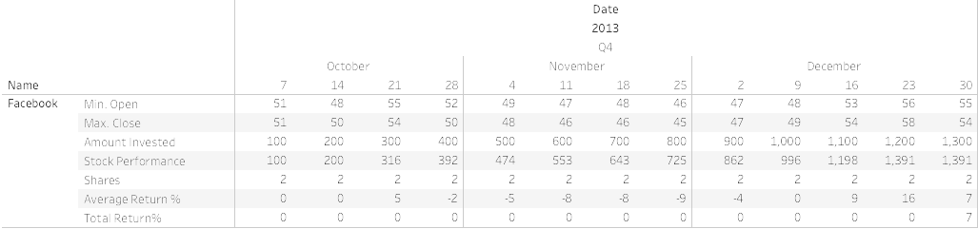
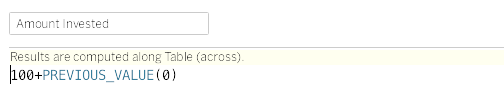
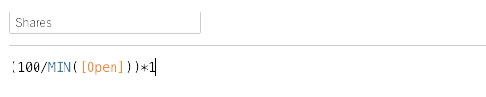
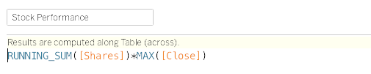
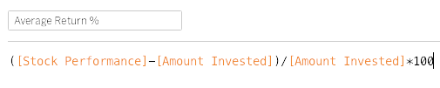
Calculated Fields (weekly recurring investment)
Example of FB from 2013 Q4 (filtered Monday)
Amount Invested - aggregate of amount invested
Shares - count of number of shares bought every week
Stock Performance - total portfolio amount (amount invested + total capital gain)
Average Return % - percentage return of current portfolio value

Slide 8
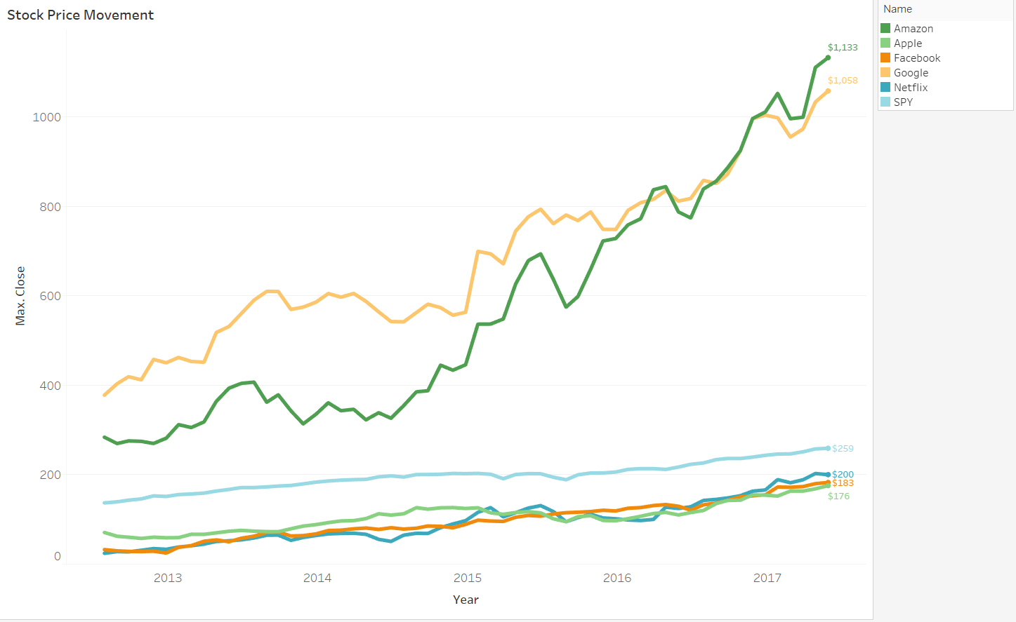
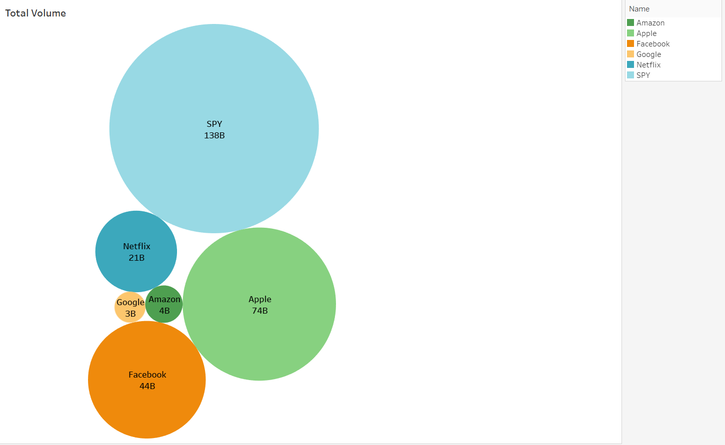
Visualizations

Slide 9
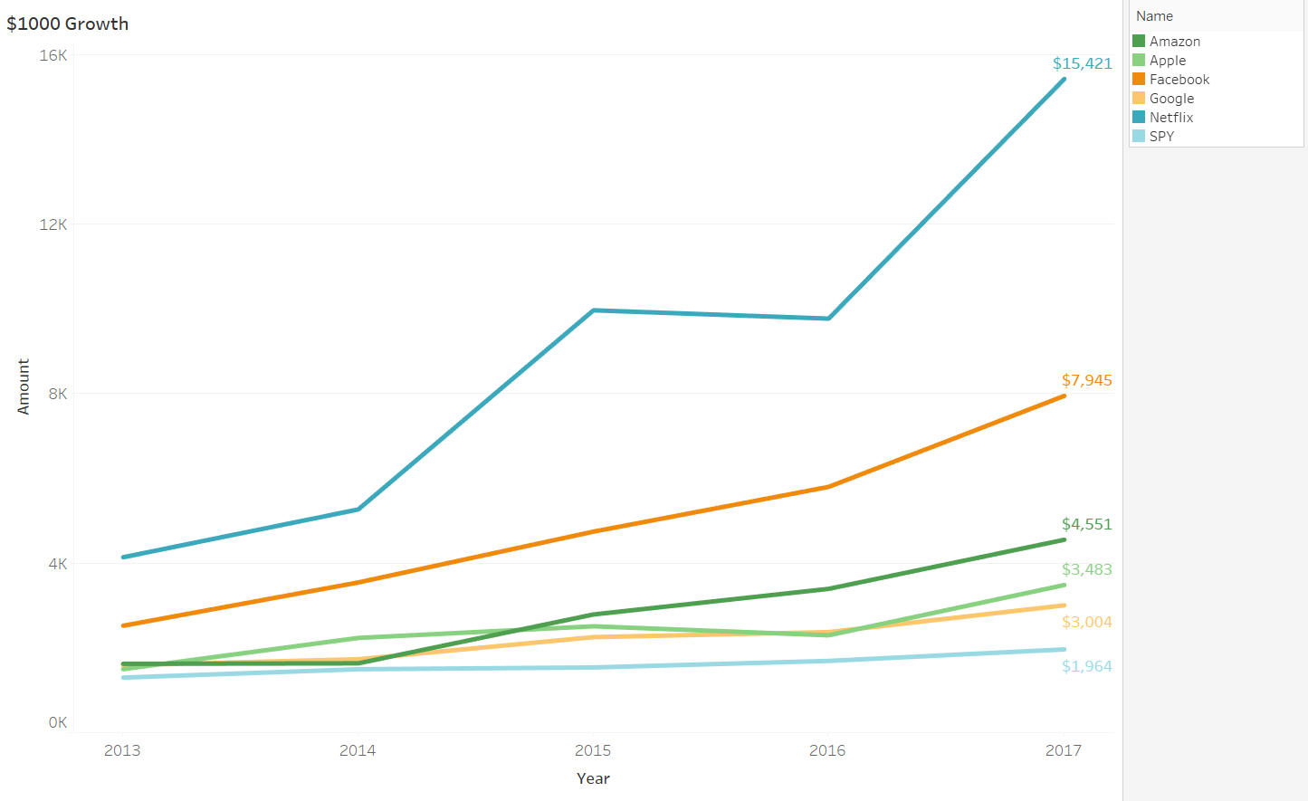
Visualizations

Slide 10
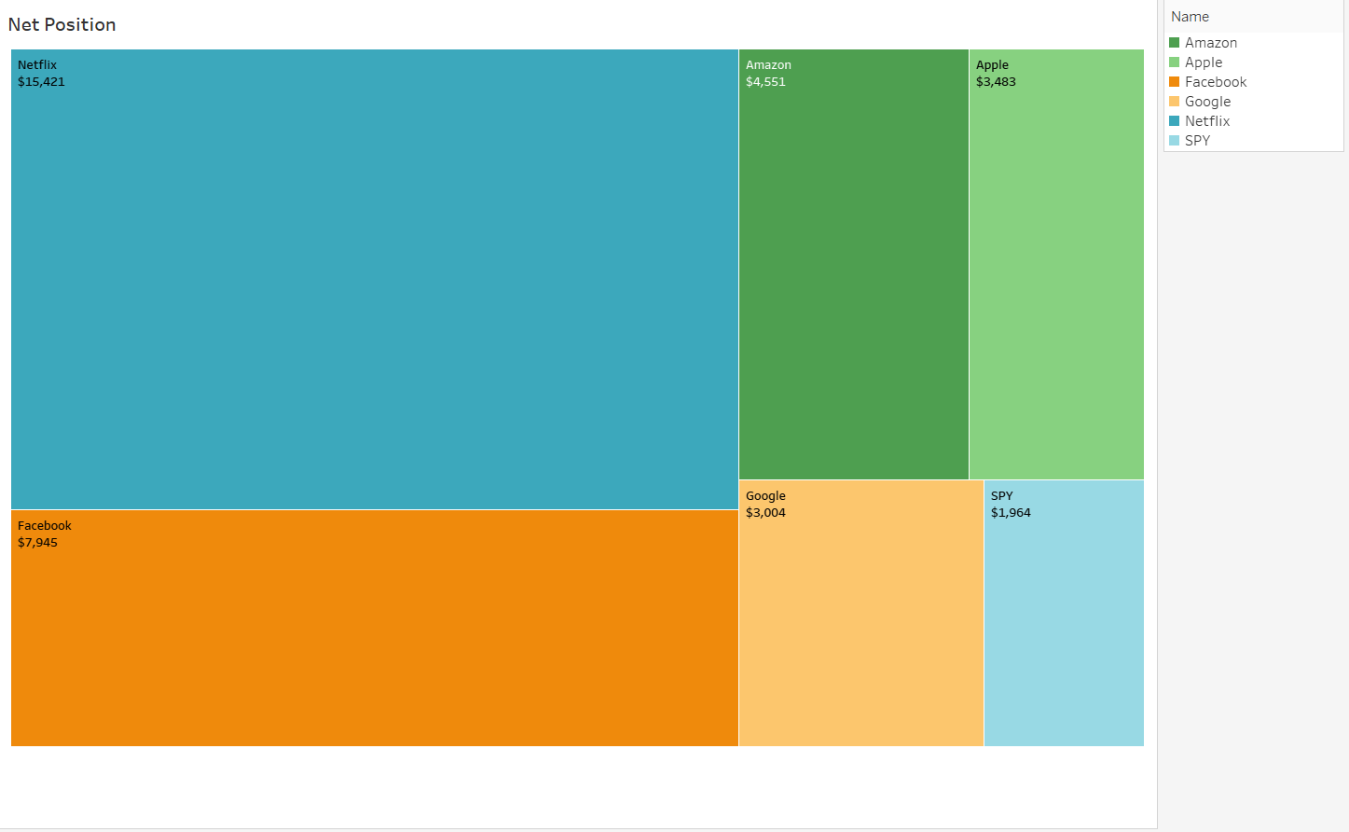
Visualizations

Slide 11
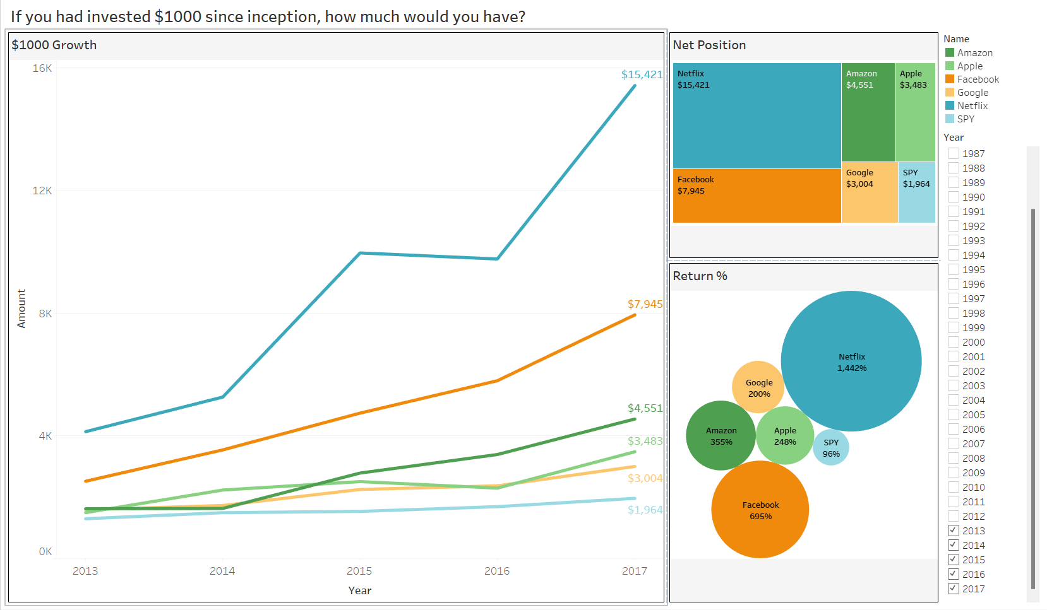
Dashboard 1

Slide 12
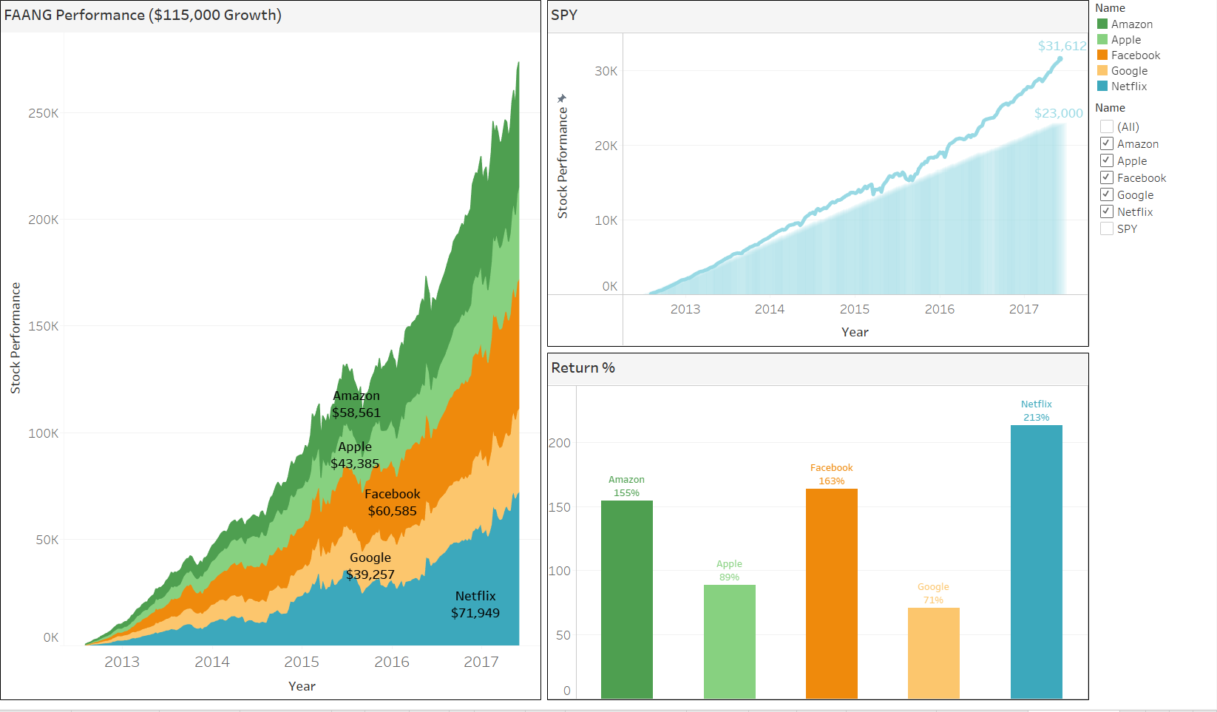
Dashboard 2

Slide 13
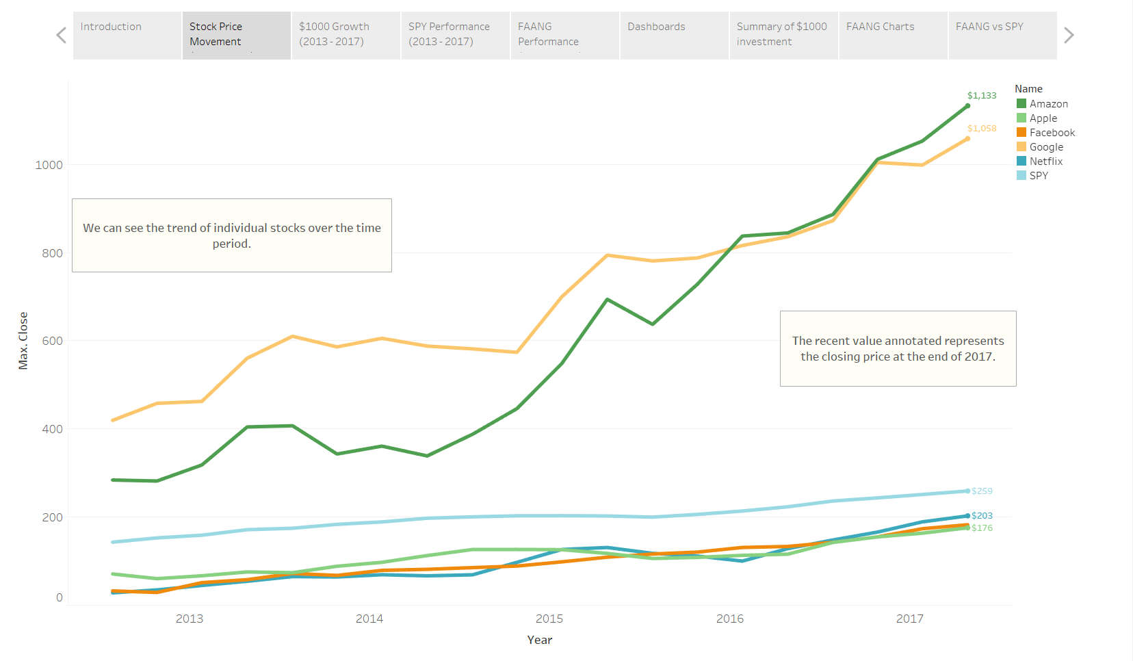
Story

Slide 14


Slide 15


